Slide 1

SEICHE 2022 Introduction to Arduino
Instructor: Paul Frommeyer
Corporate Sponsors
DXC Technology
PFC Networks

Slide 2
YOUR INSTRUCTOR
Career
Computer Networking Architect (30+ yrs)
Apple Computer – Sony – General Magic
Cisco Systems – HP/HPE/DXC [current]
Also Linux/Unix Sysadmin
Also C developer (entry level)
BS Computer Science, BS Philosophy
Personal
Ubergeek-at-large
Computers, electronics, woodworking - Electronics since 6th grade - Computers sicne 7th grade

Slide 3
“Lesson” 1 – Intro and Setup
Part A
Introduction to class format
Overview of lesson plan
Presentation format (monitor, camera, screen, whiteboard)
Inventory of Arduino kits
Part B
Review of Laptop GUI operation
Initial review of electricity basics

Slide 4
Class Format “Minimum needed to do cool stuff”
Goals
Software installation
Load software onto microcontroller
Arduino software basics
DC electricity basics
Digital Multimeter (DMM) usage
Electronic component basics
Powering microcontrollers
Connecting and using components and modules
TL; DR – Use a microcontroller and connect things to it without blowing anything up
To Be Avoided
Lots of technical details (subsequent classes)
Extensive math, computer science, or EE

Slide 5
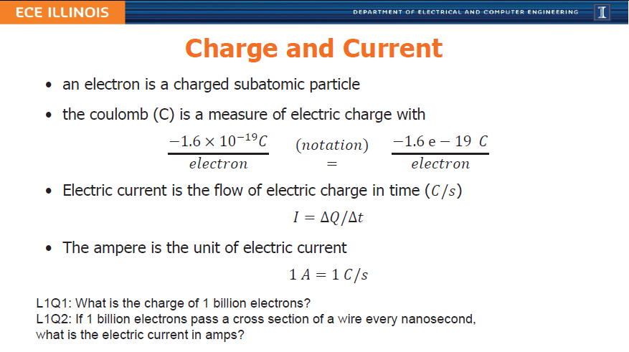
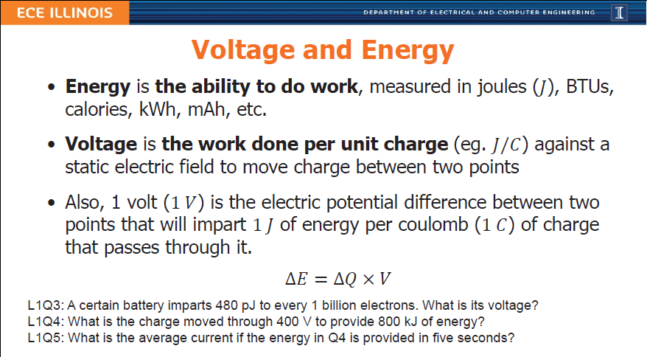
Example and Rant: What We Won’t Do
Traditional Approach
Focus on irrelevant mathematics and other high level theory
Obsessive memorization of information that can be easily and readily looked up
Assumption that full and complete knowledge is required before something can be built

Slide 6
The Maker and Hacker Approach
The maker culture is a contemporary subculture representing a technology-based extension of DIY culture that intersects with hardware-oriented parts of hacker culture and revels in the creation of new devices as well as tinkering with existing ones. The maker culture in general supports open-source hardware. Typical interests enjoyed by the maker culture include engineering-oriented pursuits such as electronics, robotics, 3-D printing, and the use of computer numeric control tools, as well as more traditional activities such as metalworking, woodworking, and, mainly, its predecessor, traditional arts and crafts.
The subculture stresses a cut-and-paste approach to standardized hobbyist technologies, and encourages cookbook re-use of designs published on websites and maker-oriented publications.[1][2] There is a strong focus on using and learning practical skills and applying them to reference designs.
– Wikipedia
The hacker culture is a subculture of individuals who enjoy the intellectual challenge of creatively overcoming the limitations of software systems to achieve novel and clever outcomes.[1] The act of engaging in activities (such as programming or other media[2]) in a spirit of playfulness and exploration is termed hacking. However, the defining characteristic of a hacker is not the activities performed themselves (e.g. programming), but how it is done[3] and whether it is exciting and meaningful.[2]
…
Richard Stallman explains about hackers who program:
What they had in common was mainly love of excellence and programming. They wanted to make their programs that they used be as good as they could. They also wanted to make them do neat things. They wanted to be able to do something in a more exciting way than anyone believed possible and show "Look how wonderful this is. I bet you didn't believe this could be done."[7]
Hackers from this subculture tend to emphatically differentiate themselves from what they pejoratively call "crackers"; those who are generally referred to by media and members of the general public using the term "hacker", and whose primary focus‍—‌be it to malign or for malevolent purposes‍—‌lies in exploiting weaknesses in computer security.[8]
– Wikipedia

Slide 7
Lesson Plan Overview
Lesson 1 – Intro and Setup
[may require 2 classes]
• Introduction to class format
• Overview of lesson plan
• Presentation format (monitor, camera, screen, whiteboard)
• Inventory of Arduino kits
• Inventory of USB drives
• Installation of Arduino software
• Installation of ESP32 serial port drivers (Windows only)
Lesson 2 – Laptop operation review
• Control panel/Settings location
• Home directories and folder hierarchy
• Arduino file locations
• Search functions
• Open questions and issues
Lesson 3 – IDE essentials
• Setting board type
• Loading example sketches
• Finding and selecting the Arduino USB port
• Uploading a sketch to the microcontroller
• Basic Arduino sketch (program) structure
Lesson 4 – Computer Data Formats
• Binary math
• Basic data types
Lesson 5 – DC Electricity Basics and DMM Intro
• Quick review: DC vs AC electric currents
• DC current operation
• Voltage vs Amperage (current)
• Introduction to basic DMM functions and usage
• Series vs parallel circuits
• Ohm’s law
Lesson 6 – Elementary Components
• Resistors
• Diodes and LED’s
• Capacitors: Electrolytic (polarized) vs non-electrolytic (non-polarized)
• Simplified transistor operation
Lesson 7 – ESP32 External power sources [may require 2 classes]
• Microcontroller board power requirements
• Board power input options
• Components with different voltage requirements
• External power circuit design
Lesson 8 – Connecting LED’s to the ESP32 controller board
• Microcontroller pinouts and diagrams
• Different types of pins
• Analog input
• Digital Input
• Digital output
• LEDs, constant current, and dropping resistors
Lesson 9 – Connecting smart LED strips
• Simplified serial communication protocols
• One-wire serial communication protocol
• Hardware vs software serial
• WS2812B and Neopixel connections
• External device power design
Lesson 10 – Connecting Sensors
• I2C serial protocol
• I2C connections
• I2C sensor board power design
• I2C sensor external power design
Lesson 11 – Connecting LCD and Matrix Displays
• The SPI serial protocol
• SPI connections
• SPI device external power design
Lesson 12 – Connecting other sensors [time permitting]
• Connecting buttons
• Connecting potentiometers
• Reading buttons
• Reading potentiometers

Slide 8
Arduino Kit Inventory
One (1) Flambeau blue tackle and project kit box with six (6) moveable plastic dividers
Two dividers installed in upper tray
Remaining dividers placed on bottom of kit box or in lid storage area
ESP32 Microcontroller – Hel-Tec Wifi Kit 32 : installed at edge of breadboard
“Upgraded” breadboard kit
Large rectangular plastic case : placed in bottom rear center of kit box
DuPont Male-Male wires : placed in upper tray front
DuPont Male-Female wires : placed in upper tray front
DuPont Female-Female wires : placed in upper tray front
Ceramic capacitors, electrolytic capacitors, diodes, transistors, photocells, RGB LED, low profile buttons, active buzzer : sorted and stored in blue clamshell case
4N35 IC, 74HC595 IC, passive buzzer, one (1) low profile button : installed on breadboard
7-13VDC breadboard power adapter : placed in middle tray right rear
Resistor packs : placed in upper tray left rear
LEDs : left in bag, stored in large rectangular plastic case
Set of breadboard jumper wires : left in small plastic case, stored in large rectangular plastic case
Two sets of long header pins : stored in large rectangular plastic case
Resistor color code reference key : stored in large rectangular plastic case
One (1) 830 series breadboard : placed in upper tray right rear
Two (2) 1000uf electrolytic capacitors : stored in large rectangular plastic case
Four (4) MAX7219 LED matrix displays on common carrier board : placed in upper tray right rear
9VDC battery clip to 5.5/2.1mm plug : placed in middle tray center right
Rotary encoder board and knob : Knob attached and assembly placed in middle tray left front
10K ohm linear B rotary potentiometer and knob : Knob attached and assembly placed in middle tray left front
120VAC to 5VDC 2000mA (2A) power supply adapter : Placed in bottom right of kit box
One (1) 2-wire screw terminal to 5.5/2.1mm female jack adapter : Attached to power adapter plug
One (1) WS2812B “Neopixel” programmable LED strip, 1 meter : placed in middle tray center
One (1) Four-in-one multibit screwdriver : placed in upper tray left front
One (1) Digital Multimeter (DMM) : placed in bottom left of kit box
One (1) set of standard test leads for DMM : placed in middle tray left
One (1) 9 volt DC battery : installed in DMM
One (1) dual red/black banana jack to dual red/black alligator clip lead adapter : bottom left of kit box
One (1) straight mini pliers with integral wire cutter : placed bottom center front of kit box
Four (4) DuPont male to mini-grabber clip test leads, 1 red, 1 black, 2 multicolor: middle tray center
One (1) USB-A male to micro-USB male adapter cable : placed in upper tray

Slide 9
Our Microcontroller Hel-tec WiFi Kit 32
Quick Specs
ESP32 – 32 bit processor
Arduino IDE compatible
Built in monochrome OLED display
3.3V DC power
Integral touch sensor capability
Integral battery charging circuitry
Integral WiFi and Bluetooth capability
Advantages
Built in OLED reduces display learning curve
ESP32 is powerful with lots of room for software code
Built-in WiFi allows for web controlled software

Slide 10
Our Microcontroller
Hel-Tec WiFi Kit 32

Slide 11
Formal End of Lesson 1
In next week’s exciting episode
Connecting your microcontrollers to your laptops
Arduino IDE Essentials
History of Telcommunications and Networking

